Slide 1
Banking Credit System
zzzz
zzzzzzz

Slide 2
Contents
1
Introduction
2
Development process
3
Demo
4
Q&A

Slide 3
Project management
Quality Assurance
Result
Introduction
Long làm
10m
Group
Presentation style
Business context
Plan
Development process
Requirement
Design
Implement
Testing
Demo
Q&A

Slide 4
Project management
Quality Assurance
Result
Introduction
Role, responsibility, time table
Giang
5m
Group
Project
Business context
Plan
Development process
Requirement
Design
Implement
Testing
Demo
Q&A

Slide 5
Project management
Quality Assurance
Result
Introduction
Ly, 10m
- Chỉ ra mỗi ng làm 1 phần (có thể dùng matrix table),
review, chỉ ra hoạt động review,
Template
3 phiên bản requirement (t Việt, t Anh, bản Doc cho report 3)
tìm hiểu nghiệp vụ
Group
Project
Business context
Plan
Development process
Requirement
Design
Implement
Testing
Demo
Q&A

Slide 6
Project management
Quality Assurance
Result
Introduction
DB design:
Goal:
- Solve business requirement.
Following 3 Normal Form
Inherit customer data
Approach:
Bottom up
Design and edit, review, mere in Visio then create DB
Result:
Picture design in visio
Group
Project
Business context
Plan
Development process
Requirement
Design
Implement
Testing
Demo
Q&A

Slide 7
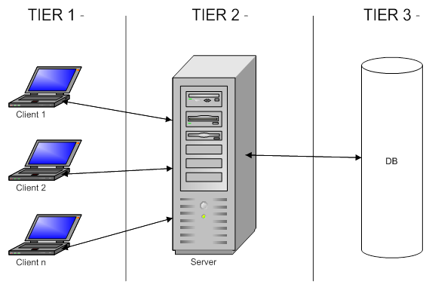
Project management
Quality Assurance
Result
Introduction
High Level design
Base on nonFunctional requirement:
Need a lot of user using common DB
We develop a three layer architecher
Group
Project
Business context
Plan
Development process
Requirement
Design
Implement
Testing
Demo
Q&A

Slide 8
Project management
Quality Assurance
Result
Introduction
=> Create a extranet web to implement our solution
Framework : Using MVC( Microsoft MVC .Net 2.0)
Advange :
beside common advange, it save our time
Group
Project
Business context
Plan
Development process
Requirement
Design
Implement
Testing
Demo
Q&A

Slide 9
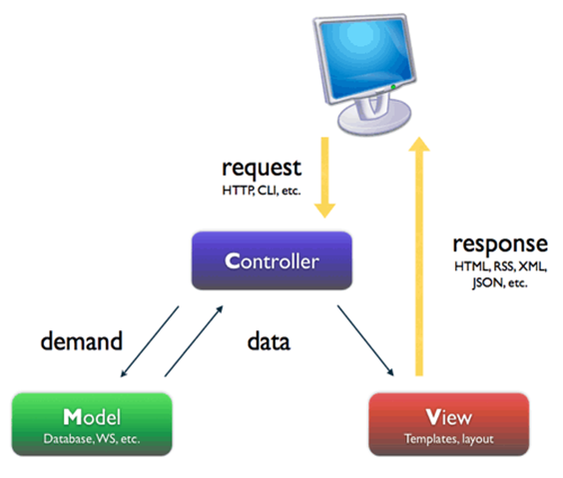
Project management
Quality Assurance
Result
Introduction
Detail Design
Group
Project
Business context
Plan
Development process
Requirement
Design
Implement
Testing
Demo
Q&A

Slide 10
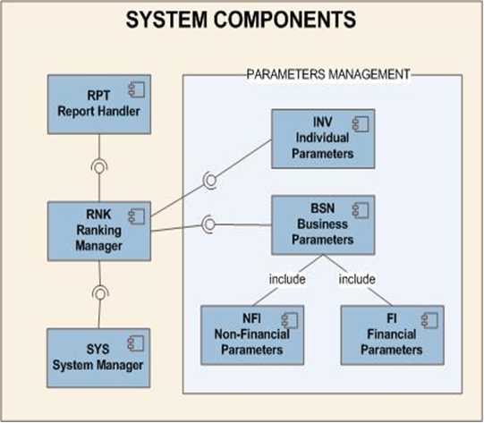
Project management
Quality Assurance
Result
Introduction
Group
Project
Component in our program:
Business context
Plan
Development process
Requirement
Design
Implement
Testing
Demo
Q&A

Slide 11
Project management
Quality Assurance
Result
Introduction
Detail Design
Approach: bottom up: each persion design a function, using our excel template and MS Visio.
Result:
Show picture
Group
Project
Business context
Plan
Development process
Requirement
Design
Implement
Testing
Demo
Q&A

Slide 12
Project management
Quality Assurance
Result
Introduction
Chính
Cho nhiều hình ảnh
Bao gồm cả DB và DDD
Model trực quan
DB: thỏa mãn chức năng của chương trình và phải kế thừa được dữ liệu, đảm bảo chuẩn 3
Architecture design: 3 tiers, middle tier: MVC
Cần đảm bảo chính xác, có khả năng cao sẽ bị thầy Trí bắt bẻ
Component diagram, modules
DDD: show ảnh
Group
Project
Business context
Plan
Development process
Requirement
Design
Implement
Testing
Demo
Q&A

Slide 13
Project management
Quality Assurance
Result
Introduction
Giang + Chính + Ly
Giang
Cách làm việc
Ly:
Ranking
Chính:
Mining, algorithms
Group
Project
Business context
Plan
Development process
Requirement
Design
Implement
Testing
Demo
Q&A

Slide 14
Project management
Quality Assurance
Result
Introduction
Thảokun + Giang, 12-15m
Cách làm việc (log bug lên google code, assign, prioroty…)
TC: viết ngay sau requirement
Thống kê
Template
Group
Project
Business context
Plan
Development process
Requirement
Design
Implement
Testing
Demo
Q&A

Slide 15
Project management
Quality Assurance
Result
Introduction
Long – 10m
Riêng phần mining: CHính
Group
Project
Business context
Plan
Development process
Requirement
Design
Implement
Testing
Demo
Q&A

Slide 16
Project management
Quality Assurance
Result
Introduction
Ro
Group
Project
Business context
Plan
Development process
Requirement
Design
Implement
Testing
Demo
Q&A

Slide 17
Project management
Quality Assurance
Result
Introduction
Ro
Group
Project
Business context
Plan
Development process
Requirement
Design
Implement
Testing
Demo
Q&A

Slide 18
Hot Tip
How do I incorporate my logo to a slide that will apply to all the other slides?
On the [View] menu, point to [Master], and then click [Slide Master] or [Notes Master]. Change images to the one you like, then it will apply to all the other slides.

Slide 19
Diagram
Title
Add your text
ThemeGallery is a Design Digital Content & Contents mall developed by Guild Design Inc.
ThemeGallery is a Design Digital Content & Contents mall developed by Guild Design Inc.

Slide 20
Cycle Diagram
Add Your Text
Text
Text
Text
Cycle name
Text
Text

Slide 21
Diagram
Text
Add Your
Title Text
Text 1
Text 2
Text 3
Text 4
Text 5
Add Your
Title Text
Text 1
Text 2
Text 3
Text 4
Text 5
Text
Text
Text
Text

Slide 22
Diagram
Text
Text
Concept
Text
Text
Text
Text
Add Your Text

Slide 23
Diagram
Add Your Text
Add Your Text
Add Your Text
Add Your Text
Add Your Text
Add Your Text
Add Your Text
Add Your Text

Slide 24
Diagram
Add Your Text
Add Your Text
Add Your
Title
Add Your Text

Slide 25
Diagram
Text
Text
Text
ThemeGallery is a Design Digital Content & Contents mall developed by Guild Design Inc.
ThemeGallery is a Design Digital Content & Contents mall developed by Guild Design Inc.
ThemeGallery is a Design Digital Content & Contents mall developed by Guild Design Inc.

Slide 26
Diagram
Text
Text
Text
Add Your Title
Text

Slide 27
Cycle Diagram
Add Your Text
B
Add Your Text
A
C
Add Your Text
Concept
E
D
Add Your Text
Add Your Text

Slide 28
Diagram
1
2
3
ThemeGallery is a Design Digital Content & Contents mall developed by Guild Design Inc.
ThemeGallery is a Design Digital Content & Contents mall developed by Guild Design Inc.
ThemeGallery is a Design Digital Content & Contents mall developed by Guild Design Inc.

Slide 29
Diagram
2001
2002
2003
2004
Your Text
Your Text
Your Text
Your Text
Your Text
Your Text
Your Text
Your Text

Slide 30
Diagram
Add Your Text
Add Your Text
Add Your Text
Add Your Text

Slide 31
Block Diagram
TEXT
TEXT
TEXT
TEXT
TEXT
TEXT
TEXT
TEXT

Slide 32
Table
 | Title | Title | Title | Title | Title
Title | O | O | O | O | O
Title | O | O | O | O | O
Title | O | O | O | O | O
Title | O | O | O | O | O
Title | O | O | O | O | O
Title | O | X | O | X | O

Slide 33
3-D Pie Chart
Text2
Text3
Text1
Text4
Text5

Slide 34
Block Diagram
Add Your Text
Add Your Text
concept
Concept
Concept
Concept

Slide 35
Thank You !
www.themegallery.com

